Slide 1

WELCOME

Slide 2
INTRODUCTION
Md.Abdul Mazed, Assistant Head Teacher
Goalbathan Secondary School
Magura Sadar, Magura.
Subject- English Second Paper
UNIT FIVE
Pronoun
Time- 50 minutes.

Slide 3
Learning Outcomes
By the end of the lesson the students will have
Learnt what preposition is.
learnt the classification of pronoun.
learnt the uses of pronoun.

Slide 4

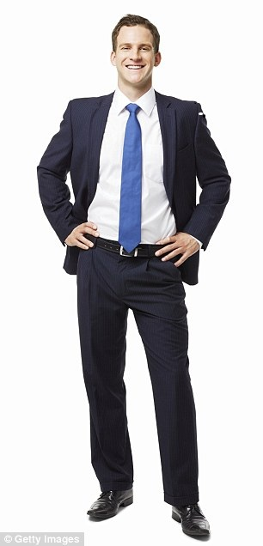
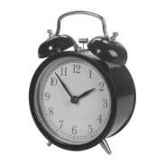
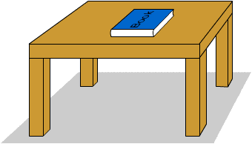
Read the conversation between Mr. Khan and Ashif;
Mr. Khan; Who gave you this book?
Ashif;I bought it from library.
Mr. Khan; What is that on the table?
Ashif; This is a clock. It gave my uncle to me.
He works in Japan.

Slide 5
The Italic words are pronouns;
A Pronoun is a word used instead of a noun.
Pronoun is of 8 kinds.
They are; 1.Personal pronoun .
2.Demonstrative pronoun.
3.Interrogative pronoun 4.Indefinite pronoun.
5.Distributive pronoun 6.Reciprocal pronoun.
7.Relative pronoun 8.Reflexive pronoun/Emphatic pronoun.

Slide 6
1.Personal Pronoun is used instead of a person or a thing and
Indicates them.
It is of three kinds; 1.First personal pronoun 2.Second personal pronoun. 3.Third personal pronoun.
Look at the following table;
person | Number | Nominative case | Objective case | Possessive case
First | Singular plural | I We | Me Us | My, mine Our, ours
Second | Singular Plural | You You | You You | Your ,Yours Your ,Yours
Third | Singular Plural | He , It She They | Him Her Them | His Her Their

Slide 7

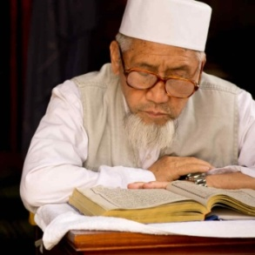
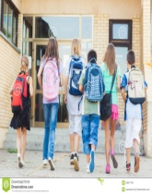

Demonstrative Pronoun
Look at the pictures and try to understand
This is a ball
That is a man
These are students
Those are flowers
A Demonstrative pronoun points to a thing or a person that
Is near or far.

Slide 8
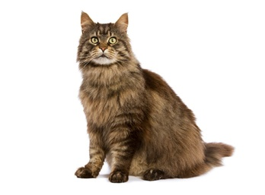
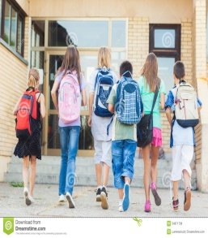
3.Interrogative pronoun;
Look at the pictures and try to understand;
What is it ?
Who are they ?
An interrogative pronoun is used to ask a question.
Example;
Who, Whom, What, Which, Whose etc.

Slide 9
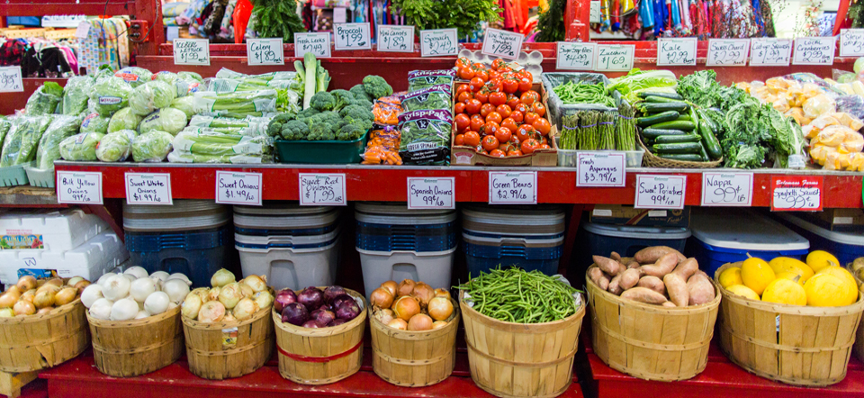
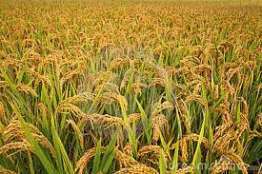
Look at the pictures and try to understand
Everything is ready for sale
Nobody went to the field

Slide 10
4. Indefinite pronoun;
Read the passage carefully and try to understand;
Everybody wants to be happy. But all can not be happy. Some are
happy while many are unhappy. One can not be happy without peace of mind. Is there anybody who is really happy ? No, there is
none.
The Italic words are indefinite pronoun.
An indefinite pronoun stands for persons or things in general
not definitely.
Example
Somebody, something. Someone, one, all, anybody, everybody,everyone, nobody, nothing, none, everything, everyone, other, some etc.

Slide 11
EVALUATION
Fill in the gaps with pronouns given in the box;
Who, None, What, Those, They He, All, Something,
1.------is better than nothing.
2.------can do the difficult sum.
3.--------do you want?
4.-------broke the glass?
5.---------are beautiful red roses.
6.-------is my elder brother.
7.-------that glitters is not gold.
8.------are good students.
THANK YOU

